Slide 1
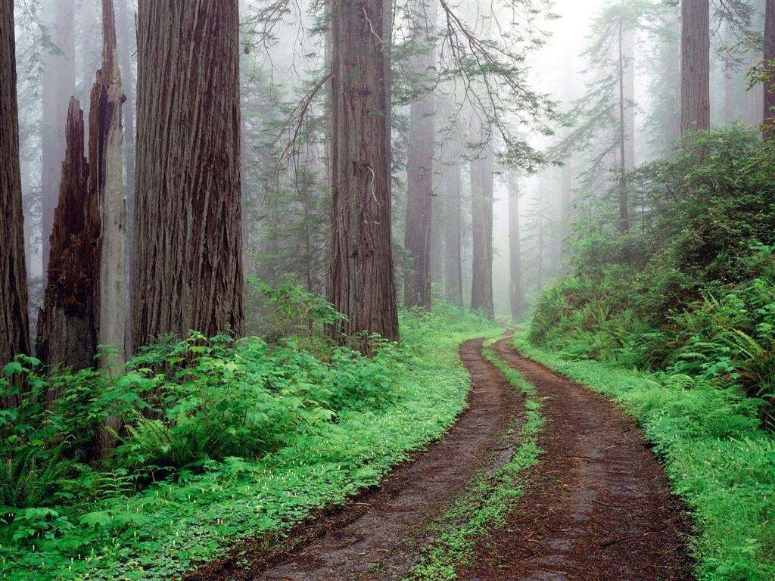
The Road Not Taken
By Robert Frost

Slide 2
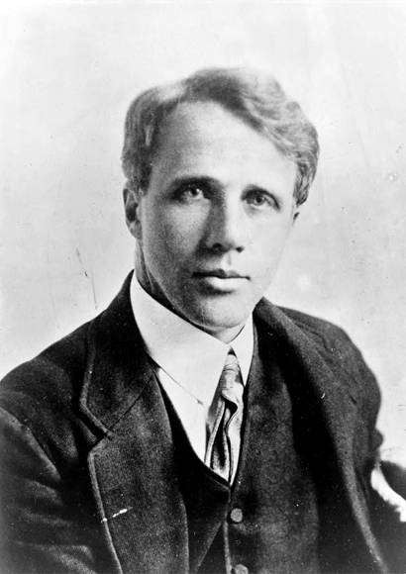
About the Poet
Robert Lee Frost (March 26, 1874 – January 29, 1963) was an American poet. His work was initially published in England before it was published in America.
He is highly regarded for his realistic depictions of rural life and his command of American colloquial speech. Frost was honored frequently during his lifetime, receiving four Pulitzer Prizes for Poetry.
He became one of America's rare public literary figures, almost an artistic institution. He was awarded the Congressional Gold Medal in 1960 for his poetical works.

Slide 3
Poem’s Title
‘The road’ is the symbol of the choice made by us in life. Many times, we regret the choice we make but what is done once cannot be undone.
Man regrets for what he has denied himself in life , rather than what he has chosen. Hence, the poet has given his poem the title “The Road Not Taken”.
  The word "road" not only means "way", it also means "journey" or a "stage of journey". Here "road" does not signify any ordinary road, but functions a metaphor of a vital decision in our life.

Slide 4
Summary Of The Poem
This poem talks about the choices one has to make in life and their consequences. One day while walking in a wooded area full of trees, the poet comes to a place where he has to decide which road he should take. He starts debating over the choices as he realizes he cannot walk on both. However he decides to take the second path with the intention of travelling on the first some other time in future

Slide 5
Subject & Themes
Choice
Independence

Slide 6
The ‘two roads’ represent a choice in life – this is a metaphor as the paths should not be seen literally
‘diverged’ – means split or divided
he regrets not being able to make both choices - as ‘one traveller’ we cannot do this
Two roads diverged in a yellow wood, And sorry I could not travel both
And be one traveler, long I stood
And looked down one as far as I could To where it bent in the undergrowth;
represents the thought process needed to make the choice.
The poem rhymes: abaab – this is a lyrical, traditional poem unlike others in the anthology

Slide 7
Summary of the first stanza
The speaker describes his position. He has been out for walking in the woods and comes in between the diversion of two roads, he stands there looking as far down each one as he can see. He would like to try out both, but doubts he could do that, so therefore he continues to look down the roads for a long time trying to make his decision about which road to take.

Slide 8
sees both choices as having equal merit – pros and cons
Then took the other, as just as fair, And having perhaps the better claim,
Because it was grassy and wanted wear; Though as for that the passing there Had worn them really about the same,
the narrator chooses the path that was grassier, hence less people had walked it in the past.
Keep remembering this is all a metaphor for the choices one has to make in life
after thinking about it he declares them worn ‘about the same’ – he contradicts himself showing us the difficulty of the decision and his hesitancy

Slide 9
Summary of the second stanza
He looked down the first one “to where it bend in the undergrowth”, and then the second one , and he decided to take the other path, because it seemed to have less traveled than the first. But then he goes on to say that they actually were very similarly worn. The second one that he took seems less traveled but as he thinks about it, he realizes that they were “really about the same”. Not exactly the same but only “about the
same”.

Slide 10
looking back, he realises that no one had chosen either path that day – both were covered with ‘leaves no step had trodden black’
And both that morning equally lay In leaves no step had trodden black. Oh, I kept the first for another day!
Yet knowing how way leads on to way, I doubted if I should ever come back.
exclamation of regret – emphasises the importance of the choice
by making a choice, your life changes and you are never able to make things exactly as they were in the past. A bit like the butterfly effect.
Even at the time of making the choice, he ‘doubted if [he] should ever come back’ – this gives a real sense of stepping into the unknown

Slide 11
Summary of the third stanza
The third stanza continues with the cogitation about the possible differences between the two road. He had noticed that the leaves were both fresh fallen on them both and had not been walked on, but then again claims that maybe he would come back and also walk the first one sometimes, but he doubted he would be able to, because in life one thing leads to another and time is short.

Slide 12
he looks to the future – he cannot be certain that his choice was the right one
I shall be telling this with a sigh Somewhere ages and ages hence: Two roads diverged in a wood, and I— I took the one less traveled by,
And that has made all the difference.
repetition of opening – poem is circular. This is Frost telling the same story again in the future
‘the difference’ - you can interpret this as you wish but it is important that you do think about its meaning. Frost himself says this final line does not mean he made the right choice, rather that he had to make the choice and it changed everything

Slide 13
Summary of the fourth stanza
In this poem the word “difference” is taken in a positive way. But there is nothing in the poem that suggests that this difference signals a positive outcome. The speaker could not offer such information, because he has not lived the “difference” yet.
The other word that leads non-discerning readers astray is the word “sigh.” By taking “difference” to mean a positive difference, they think that the sigh is one of nostalgic relief; however, a sigh can also mean regret. There is the “oh, dear” kind of sigh, but also the “what a relief” kind of sigh. Which one is it? We do not know. If it is the relief sigh, then the difference means the speaker is glad he took the road he did; if it is the regret sigh, then the difference would not be good, and the speaker would be sighing in regret.

Slide 14
Links to other poems…
‘Warning’ probably works the best as it is also about a risky choice.
In ‘Digging’, Seamus Heaney chooses to become a poet rather than follow in his father’s footsteps.

Slide 15
Hints and Tips
This is a lovely poem but relating it to the others in the anthology might be difficult. If you do choose to write about it, you must be clear that the poem is a metaphor for the choices in life; if you do NOT understand this ask me or someone else what it means because an examiner will not be impressed if you do not show an understanding of this.
Try to imagine a choice. For example, a girl who becomes pregnant and whether or not she should have an abortion, or the decision to stay on at school/college or go straight into work. Try to relate the choice to the poem and you should find it easier.
This analysis is excellent: http://poetry.suite101.com/article.cfm/robert_frost_s_tricky_p if you want any more info.

Slide 16
Example Questions
‘The Road Not Taken’ is a poem about the decisions you can make in life. Choose another poem where the narrator has made a choice or is thinking about making a choice. How do they compare?
The ‘two roads’ in this poem are a metaphor. Find another metaphor in a different poem and explain how these uses of figurative language illustrate the poems’ themes.

